Slide 1
US Commodity Flow
Boer Feng, Chris bunker, pat steeves, xinyi lu

Slide 2
The Data
US Census Data from 2012 on commodity shipments in and out of each state
Original data: >4 million
Sample Size: 1,000,000 records
Used Trifacta to clean up the data

Slide 3
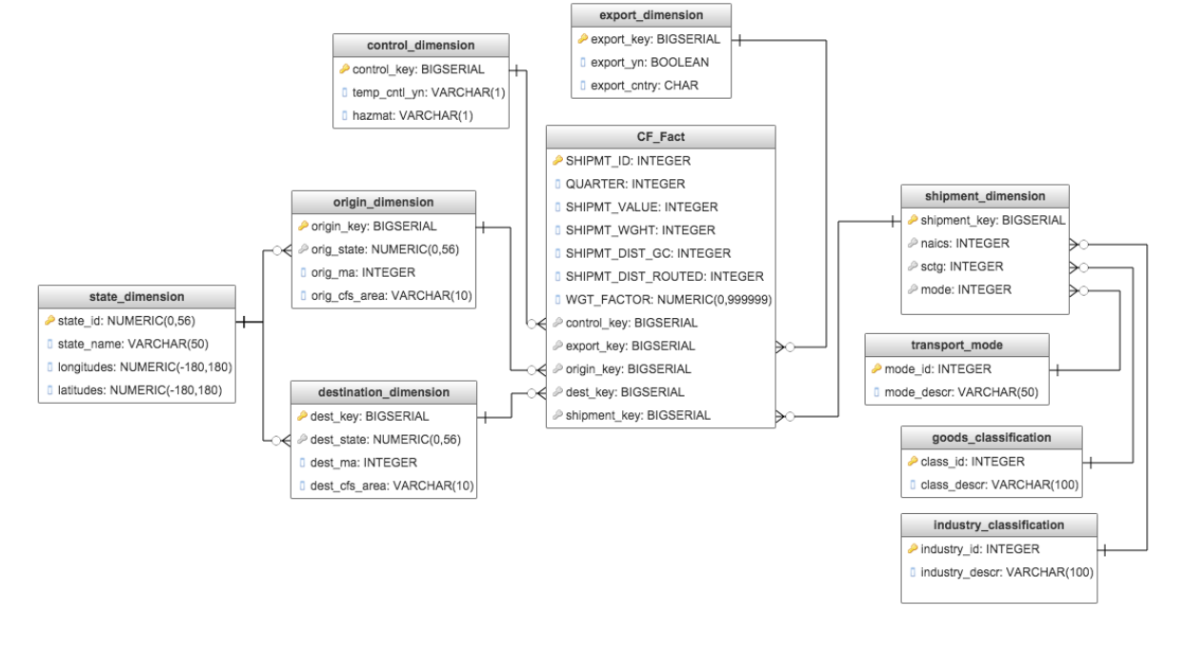
Dimensional Database w/ Star Schema
Reference dimensions created manually

Slide 4
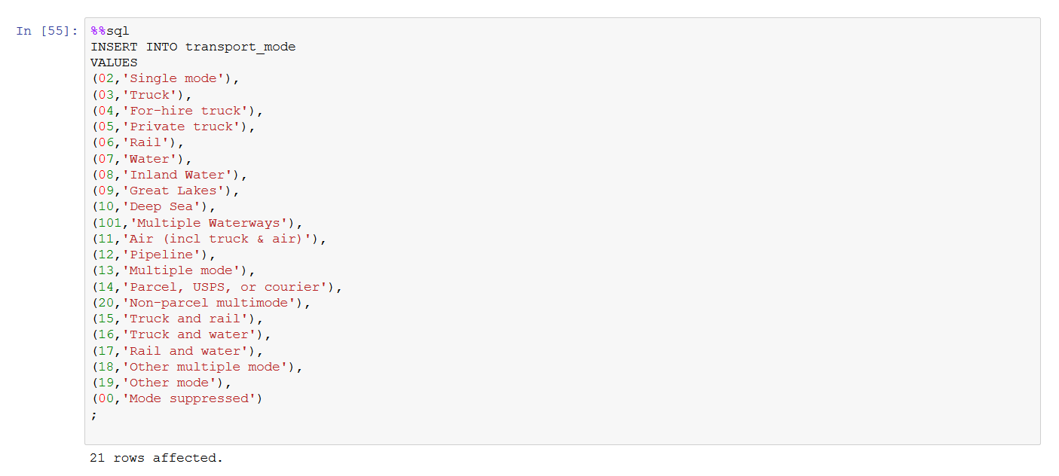
Manually Input Data: Transport

Slide 5
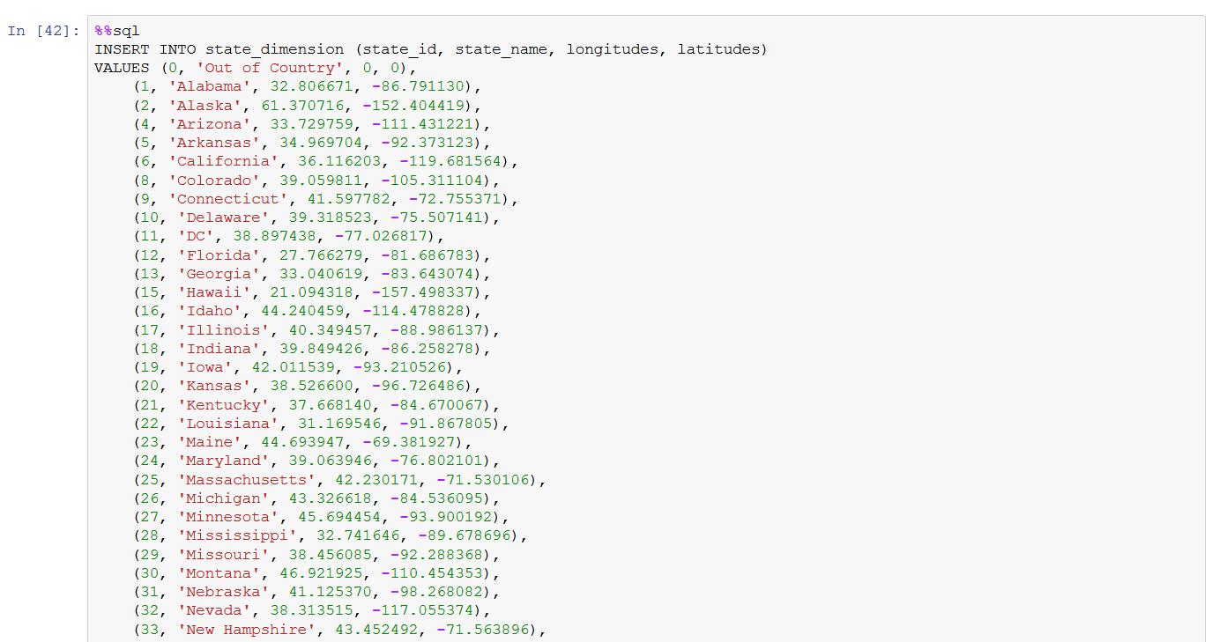
State Input

Slide 6
Data Analysis

Slide 7
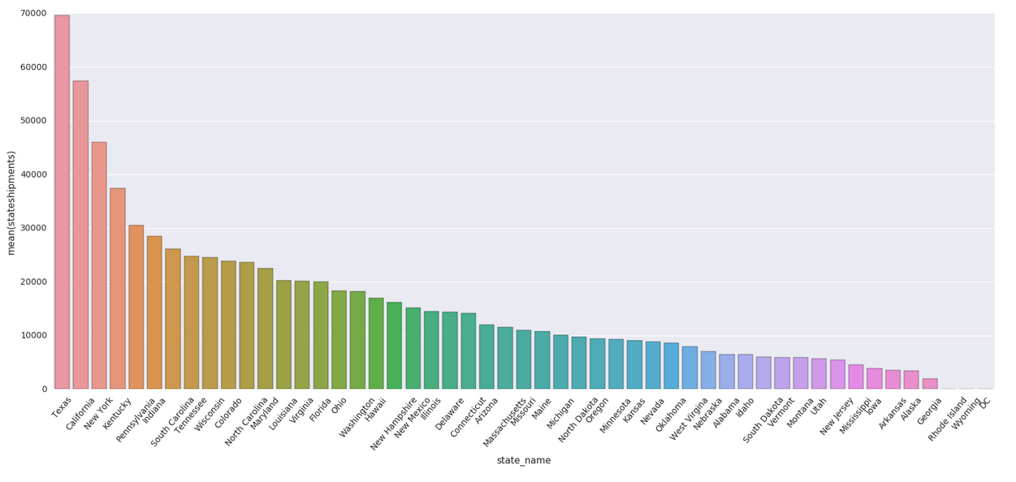
Import Analysis (did the same for exports)

Slide 8
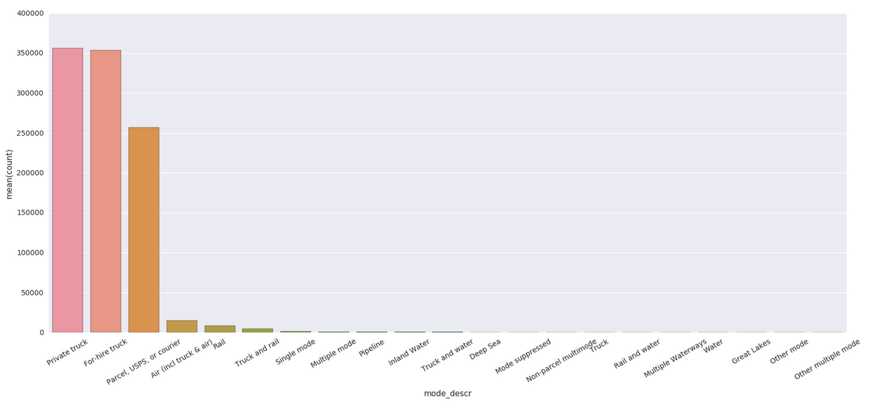
Transport Analysis

Slide 9
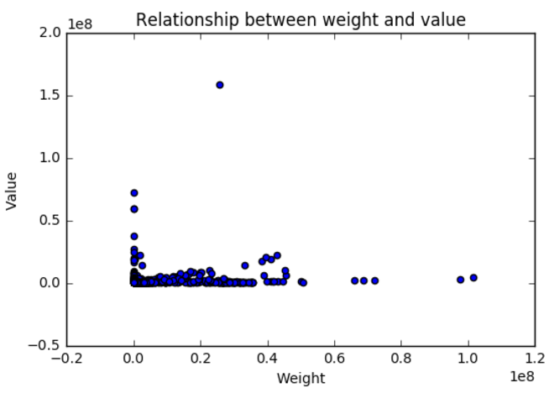
Shipment Weight and Value

Slide 10
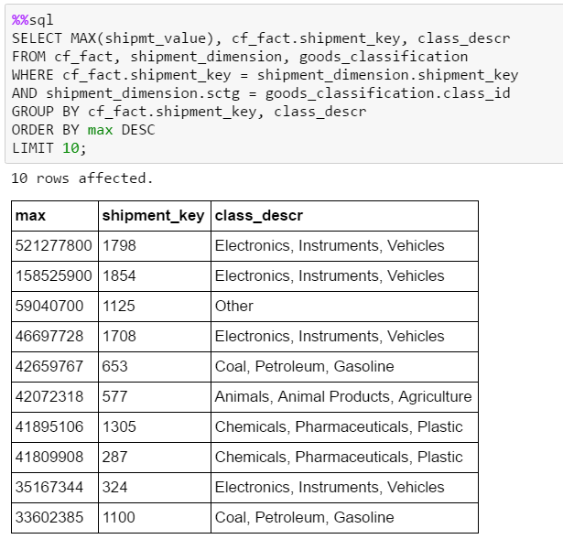
Max Values

Slide 11
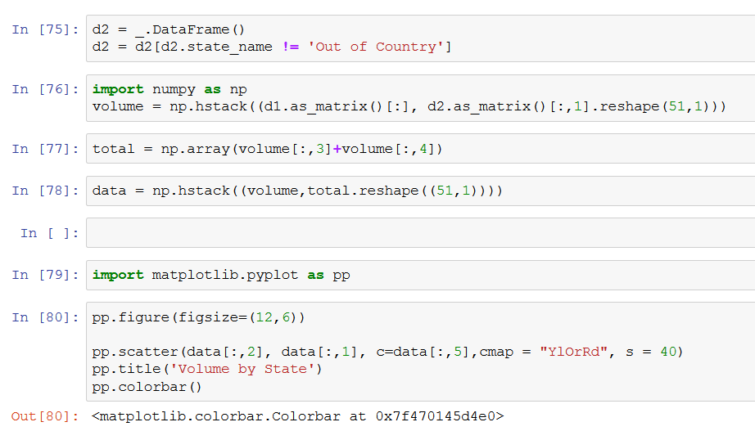
Volume By State Diagram

Slide 12
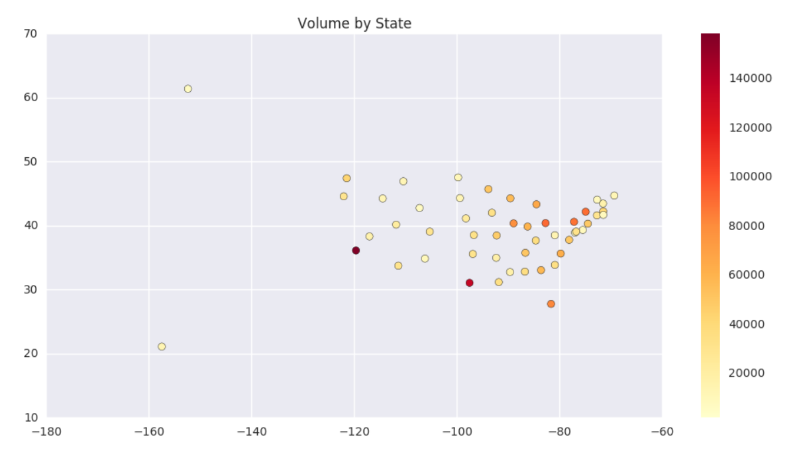

Slide 13
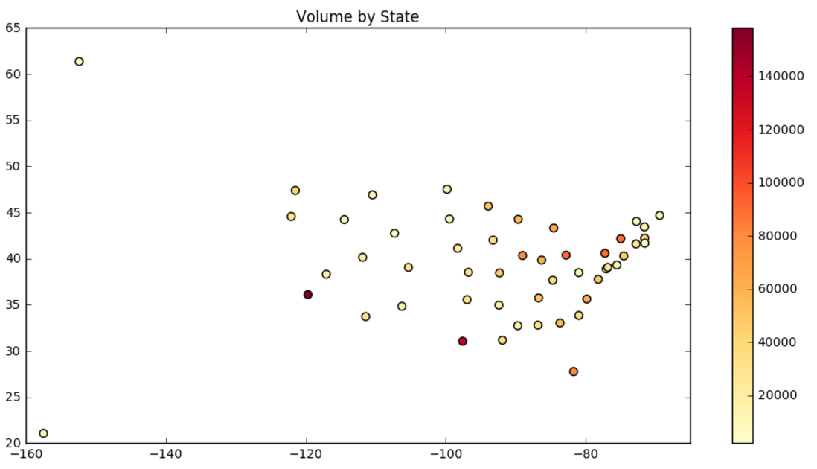


Slide 14
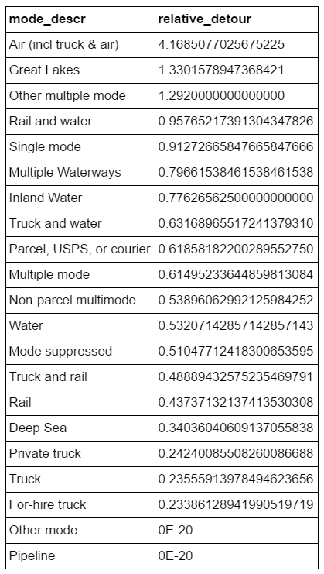
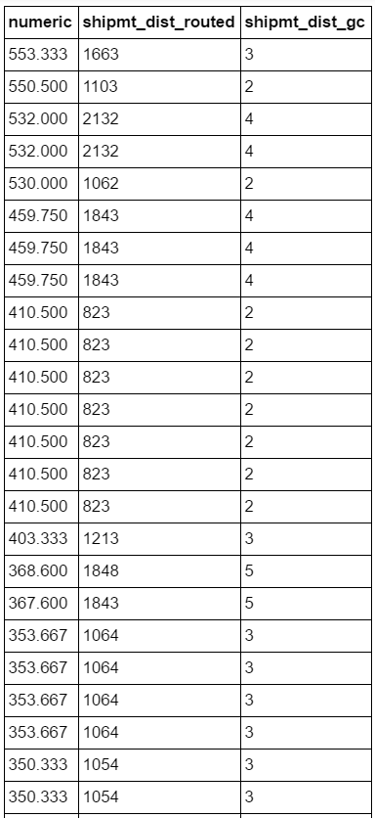
Routing Information

